Slide 1

DBMS MINI PROJECT

Slide 2
Title: Hospital Management System

Slide 3
Team Members:
1.) Nandini (RA2011031010003)
2.) Shivendra Bharuka (RA2011031010020) 3.) Stuti Jain (RA2011031010031)

Slide 4
Abstract:
Hospital Management System (HMS) is a crucial component of the healthcare industry, as it streamlines various processes and enhances the overall efficiency of healthcare organizations. This system integrates various functions, such as patient management, medical records, appointment scheduling, billing, and inventory management, into a single platform. The use of HMS leads to improved patient care, reduced costs, and increased productivity. This study focuses on the design and implementation of a comprehensive HMS, with a user-friendly interface and advanced features to meet the needs of healthcare organizations. The system is developed using modern technologies, such as cloud computing and database management, to ensure scalability, reliability, and security. The results of this study demonstrate the feasibility and effectiveness of the developed HMS, and its potential to improve the quality of healthcare delivery and patient outcomes.

Slide 5
Problem Statement:
The healthcare industry is facing numerous challenges, such as increasing patient volume, limited resources, and rising costs, which are affecting the quality of healthcare delivery. To address these challenges, many healthcare organizations are turning to technology- driven solutions, such as Hospital Management Systems (HMS). However, the current HMS solutions available in the market often lack integration with a centralized database, leading to fragmented information and manual processes.

Slide 6
Objective:
The objective of this study is to design and implement a comprehensive HMS in DBMS that integrates various functions, such as patient management, medical records, appointment scheduling, billing, and inventory management, into a single platform. The system should have a user-friendly interface and advanced features, such as data analytics, to meet the needs of healthcare organizations. Additionally, the HMS should be developed using modern technologies, such as cloud computing and database management, to ensure scalability, reliability, and security.

Slide 7
Scope of project:
Patient Management: The HMS should allow healthcare organizations to efficiently manage patient information, including demographics, medical history, and insurance details.
Medical Records Management: The system should enable healthcare providers to easily access and manage electronic medical records, including diagnostic test results, prescriptions, and progress notes.
Appointment Scheduling: The HMS should provide an efficient
appointment appointments schedules.
scheduling system, enabling patients to and healthcare providers to manage
book their

Slide 8
Billing and Payment Management: The system should have an integrated billing and payment management system, which can handle insurance claims, co-payments, and patient billing.
Inventory Management: The HMS should have an inventory management system, which can track and manage medical supplies, equipment, and drugs.
Data Analytics: The system should provide real-time data analytics and reporting, enabling healthcare organizations to make informed decisions based on data.
Security and Privacy: The HMS should ensure the security and privacy of patient information, in compliance with regulations such as HIPAA.

Slide 9

User Management: The system should have a user management system, which can manage user access to the system based roles and permiss

Slide 10
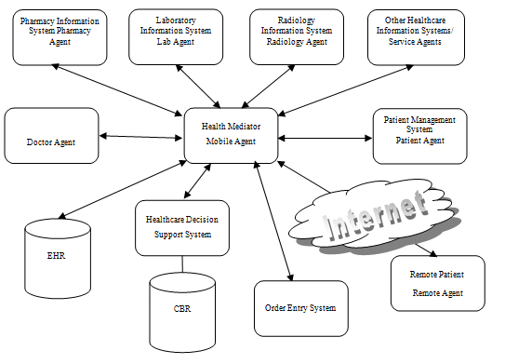
System Architecture:

Slide 11
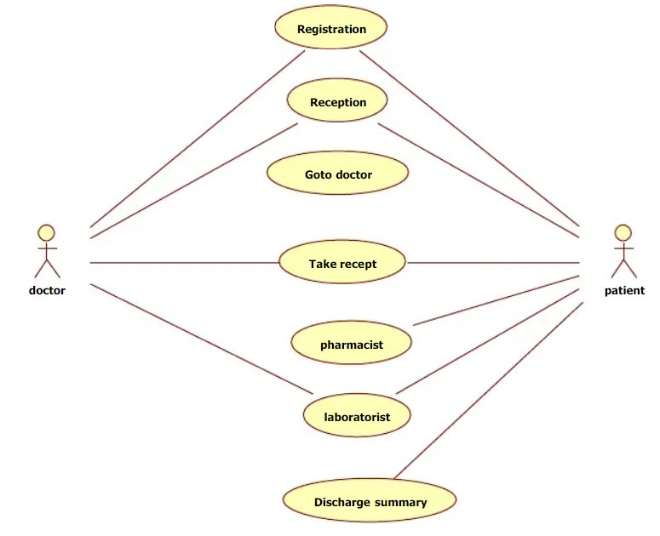
Use Case Diagram:

Slide 12

References:
https://www.academia.edu/7149341/HOSPITAL_MANAGEMENT_SYSTE M_A_PROJECT_REPORT_Submitted_in_Partial_Fulfillment_of_the_requi rements_for_the_Award_of_the
https://www.studocu.com/in/document/gujarat- university/mscit/hospital-management-system-project- rdbms/26465589

